Slide 1

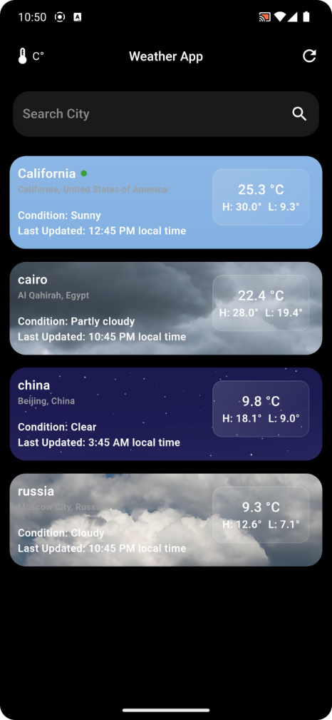

Weather Application
Welcome to our presentation on the development of a weather app! We will explore the key components, features, and challenges of creating a user-friendly and informative weather application.
Mahmoud ELDemerdash
Nada Wahba
Toka Abdelfatah
Mohamed Hassan
Mahmoud Mohamed

Slide 2
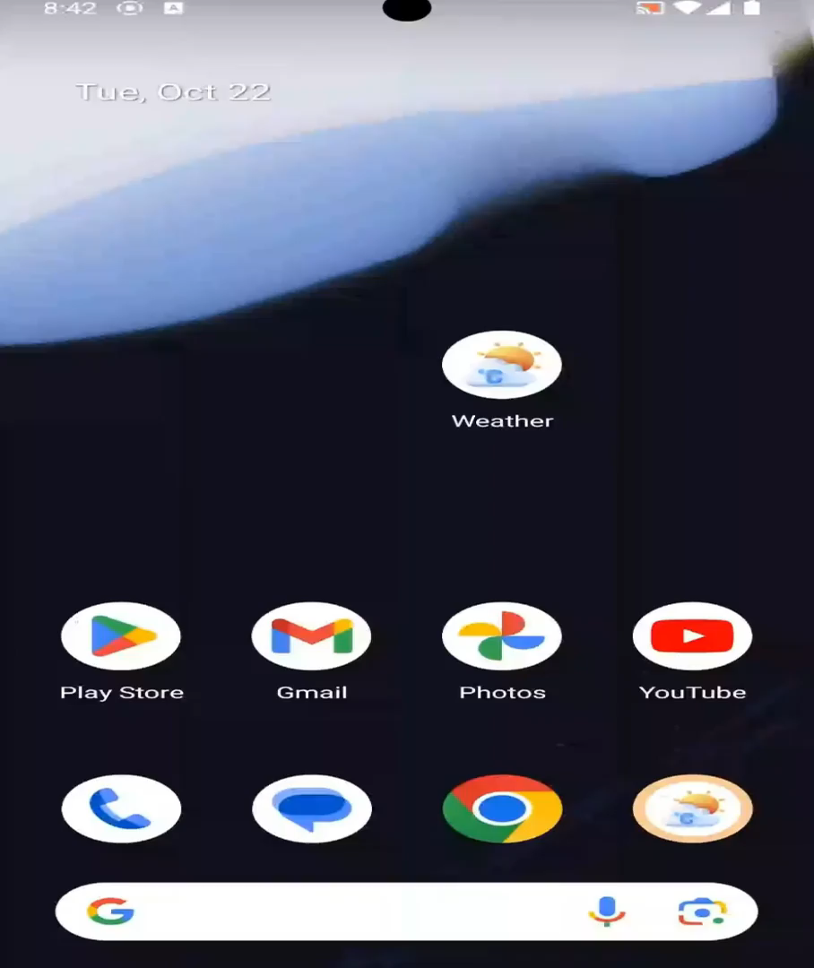
Weather Application
Welcome to our presentation on the development of a weather app! We will explore the key components, features, and challenges of creating a user-friendly and informative weather application.
Mahmoud ELDemerdash
Nada Wahba
Toka Abdelfatah
Mohamed Hassan
Mahmoud Mohamed

Slide 3

The Structure of our Application
Services
Logic
Presentation
This layer provides the core functionality of the application, including weather data retrieval, location handling, notifications, and robust error management. This ensures a smooth and reliable user experience.
This layer utilizes state management solutions like Provider to manage application data and behavior, ensuring a seamless and consistent user experience. It's responsible for three key functions:
This layer is responsible for delivering a visually appealing and intuitive user interface to delight users.
The application has two main screens:
getWeather(String cityName) getUserCity() Notification()
class Failure
fetchWeatherModel(cityName)
fetchUserCity() saveCitiesList()
HomePage() WeatherDetailsPage()

Slide 4

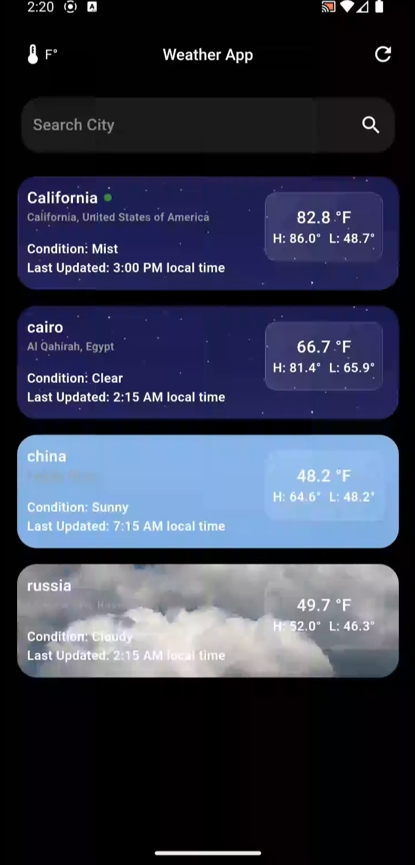


App Services: Error Handling
Implementing robust error handling mechanisms to gracefully manage API-related failures and provide meaningful feedback to users.
abstract class Failure (errMsg)
class ServerFailure extends Failure{
factory ServerFailure.fromDioException(dioException)
}
class Location Failure extends Failure
class CurrentLocationException implements Exception

Slide 5

App Services: Location Handling
This service layer focuses on providing accurate and up-to-date location information for the weather app. Here's a breakdown of the key components and functions:
1
Geolocation API
2
Address Lookup
Leveraging the device's GPS to retrieve the user's current location and track their movements.
Translating geographical coordinates into human-readable addresses for improved user experience.
Future<Either<LocationFailure, String?>> getCurrentCity() async {
try {
Position position = await _determinePosition();
List<Placemark> locationDetails =
await placemarkFromCoordinates(position.latitude, position.longitude);
String? city = locationDetails[0].administrativeArea;
return right(city);
} on CurrentLocationException catch (e) {
return left(LocationFailure(e.cause));
} catch (e) {
return left(LocationFailure("Error!!"));
}
}

Slide 6

App Services: API Integration
This service layer focuses on providing accurate and up-to-date location information for the weather app. Here's a breakdown of the key components and functions:
1
Response Parsing
2
Error Handling
Efficiently parsing API responses and transforming the data into a format that can be easily consumed by the app's logic.
Implementing robust error handling mechanisms to gracefully manage API-related failures and provide meaningful feedback to users.
Future<Either<Failure, WeatherModel>> getWeatherForCity(String cityName) async {
try {
Response response = await dio.get(
"$baseUrl/forecast.json?key=$apiKey&q=$cityName&days=3&aqi=yes&alerts=yes");
www.weatherapi.com
WeatherModel weatherModel = WeatherModel.fromJson(response.data);
return right(weatherModel);
} on DioException catch (dioException) {
return left(ServerFailure.fromDioException(dioException));
} catch (e) {
return left(ServerFailure("Unexpected error!!"));
}
}

Slide 7



App Services: Notification Management
Push Notifications
Tools & Packages
Issues and Solutions
service layer focuses on providing a notification every day at 7 AM to give the user the weather of day.
flutter_local_notifications:
for notification management
workmanager:
for background task scheduling
timezone:
for handling time zones
Handling time zones to ensure accurate notification timing
Ensuring reliable background task execution

Slide 8

App Logic: Provider State Management
Experience real-time updates and seamless UI synchronization with Provider's ChangeNotifier, driving a sophisticated architecture that elegantly divides the app's logic and presentation.
Fetch Data from Services
Transfer Data to UI
Call Services to fetch UserCity
String userCity;
Future<void> fetchUserCity(BuildContext context) async {
try {
Either<LocationFailure, String?> cityResult =await LocationService().getCurrentCity();
cityResult.fold(
(city) async {
userCity = city;
notifyListeners();
},
(failure) {Helpers.showSnackBar(context, failure.errMsg);},
);
} catch (e) {
Helpers.showSnackBar(context, 'Unexpected error: $e');
}
}

Slide 9

App Logic: Provider State Management
Experience real-time updates and seamless UI synchronization with Provider's ChangeNotifier, driving a sophisticated architecture that elegantly divides the app's logic and presentation.
Call Api to fetch WeatherModel
Future<WeatherModel?> fetchWeatherModel( String cityName, BuildContext context) async {
WeatherModel? weatherModel;
try {
Either<Failure, WeatherModel> weatherResult = await WeatherService().getWeatherForCity(cityName);
weatherResult.fold(
(weather) {
weatherModel = weather;
},
return weatherModel;
}
(failure) {
Helpers.showSnackBar(context, 'Error fetching weather for $cityName: ${failure.errMsg}');
},
);
} catch (e) {
Helpers.showSnackBar(context, 'Error fetching weather for $cityName');
}

Slide 10

App Logic: Provider State Management
Experience real-time updates and seamless UI synchronization with Provider's ChangeNotifier, driving a sophisticated architecture that elegantly divides the app's logic and presentation.
Save Cities List using shared preferences
List<String> selectedCities ;
addCity(cityName) => selectedCities.add(cityName)
removeCity(index) => selectedCities.removeAt(index)
saveSelectedCities() => prefs.setStringList('selectedCities', selectedCities)
loadSelectedCities() => selectedCities = prefs.getStringList('selectedCities')

Slide 11
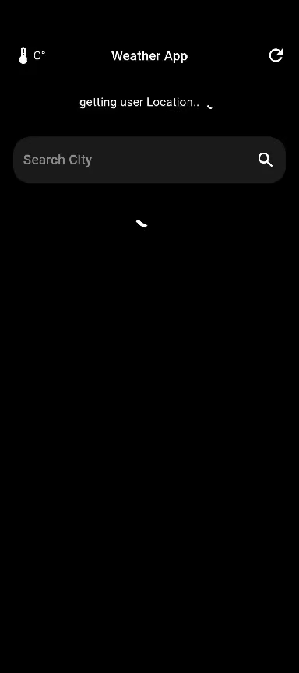

App Presentation: UI Design
Home Screen
A visually appealing and user-friendly home screen that sets the tone for the app's overall experience.
ListView.builder(
itemCount: Provider.of(context). selectedCities. length + 1,
itemBuilder: (context, index) {
if (index == 0) return LiveWeatherCard ();
else return DismissibleCard ( index: index - 1 );
},
)

Slide 12

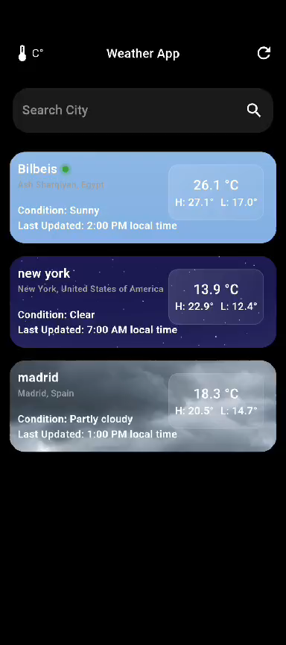
App Presentation: UI Design
Weather Details Screen
The Details screen offers a visually appealing and user-friendly interface, showcasing comprehensive weather information in a way that's easy to understand and navigate.
CityWeatherScreen()

Slide 13
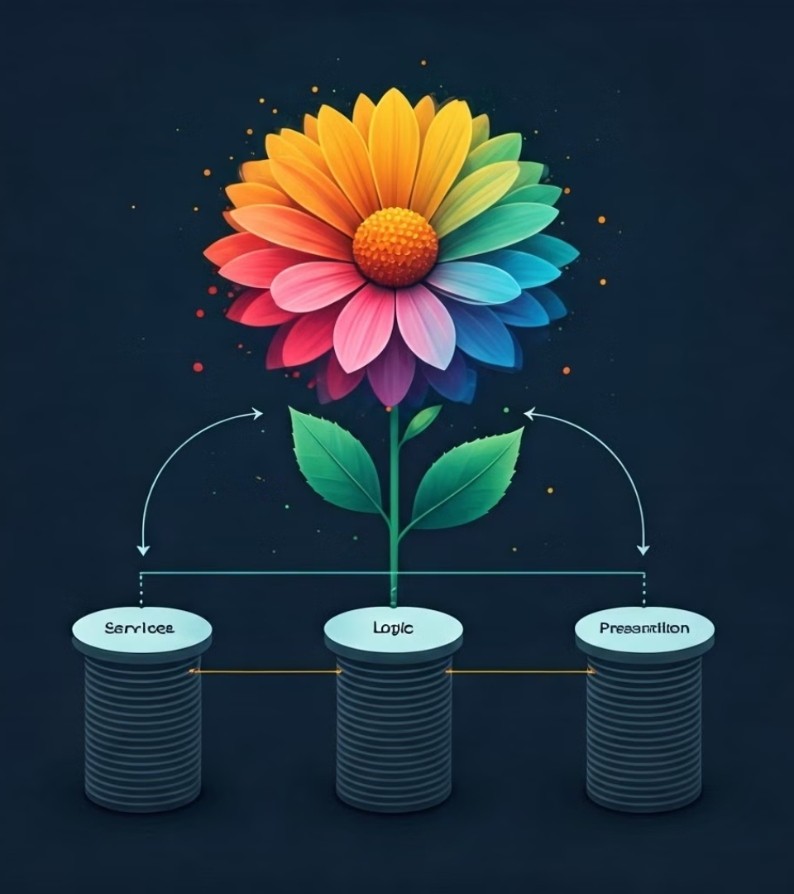
Bringing
It
All
Together

Slide 14
Thank You

